Slide 1
Opening up Analytics
Sarah Culkin, Analytics Unit, NHSX
November 2020

Slide 2

NHSX
A joint unit focussed on accelerating the digitisation of health and care
Providing consistent and coherent digital, data and technology policy
Leading the development of strategy, programme and project delivery

Slide 3
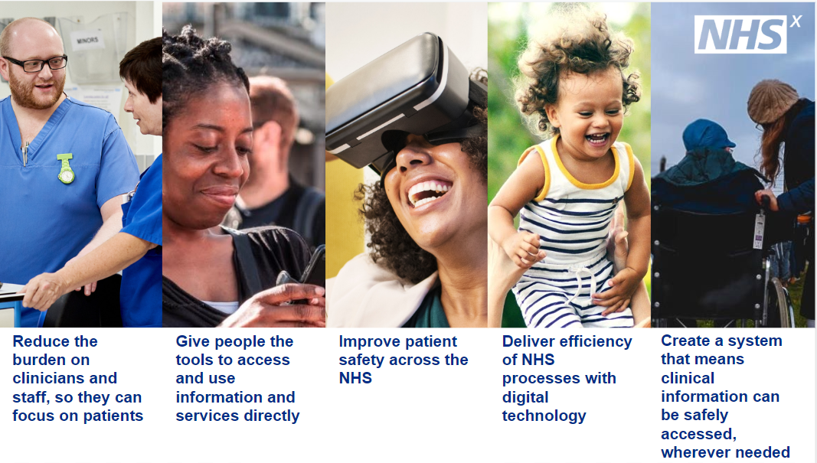
Overview of NHSX
NHSX will deliver the Health Secretary’s Tech Vision, building on the NHS Long Term Plan. We will speed up the digital transformation of the NHS and social care. We have set ourselves five missions, which are focused on how we can make things better for patients and staff.
These are:

Slide 4
Analytics Unit
The Analytics Unit is one of six teams within the Policy and Strategy Directorate.
The Unit aims to modernise and strengthen the use of data and analytics across the health and social care system and support digital transformation.
The Unit consists of analysts, economists, data scientists, data engineers, data developers and a comms manager that sit across three workstreams.
Vestibulum congue
Analytics as a Profession
Analytics Unit
Vestibulum congue
Programme Analytics
Vestibulum congue
Innovative
Analytics

Slide 5
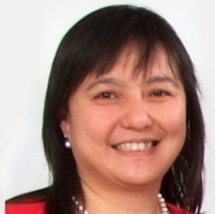
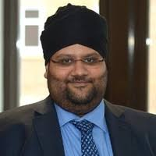
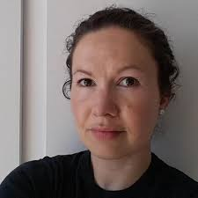
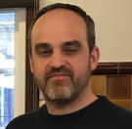


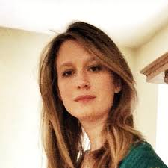
Team
Sukhmeet Panesar
Sarah Culkin
Deputy Director of Strategy and Development
NHSEI
Head of Analytics
NHSX
Ming Tang
Director of Data and Analytics
NHSEI
Jake Abbas
VACANCY
Head of Local Knowledge and Intelligence Services
PHE
Analytics Profession Lead
NHSX
Sarah Blundell
Pollyanna Jones
Head of IAU
NHSEI
Head of Innovation and Collaboration
NHSEI
Alex Cheung
Knowledge Manager
NHSEI

Slide 6
Understanding the analytics workforce
Informatics Workforce: Digital Readiness (previously known as Building A Digital Ready Workforce) (HEE, NHSX, NHSEI)
Digital, Data and Technology (DDaT)
(GDS)
Data
IT operations
Product and
delivery
Quality assurance
testing
Technical
User-centred
design
Data Analyst
Data Engineer
Data Scientist
Performance Analyst

Slide 7
Ecosystem Enabler
Data
NHSX and NHSE/I will partner and use their roles as central bodies to sit in the middle to ensure alignment, clarity and cohesiveness of approach.
Both organisations will play an ecosystem enabler role bringing together the various partners to help steer national policies and directives on developing analysis as a profession.
NHSE/I + NHSX
HEE
AphA
The Health Foundation
Strategy unit
PHE
NHS-R community
NW informatics skills network

Slide 8
The three foundations
1
2
3
Framework and Guidance
Community and Development
Innovation and Sharing
Push single analytical Framework
DDat Data family
Push Change on job role in ESR
From Admin/Clerical to Scientific/Clinical
Supporting National Networks and Conferences
Better resource AphA
Support of NHS-R community
Develop conference and events in tandem
Open Sharing of Code
Demonstrate coding in the open and sharing primarily through GitHub.
Create exemplars for NHS analysis and engage with the analyst community to encourage sharing of work and best practice
Interoperable ways of working
Demonstrate and advise on interoperable ways of working so that data and models can be reproduced across different architectures
Encourage use of modern data formats to increase machine digestible data
Support the usage of IT structure agnostic solutions and documentation which allows reproducibility over one-off specific solutions.
Publish Policies
E.g. IT usage
Include in data strategy and other standards work
Aligning with other Government professions
Evaluation, Statistics, Policy, Social Research, Operational Research, Economics
Data and analytics learning path
Open to all NHS analysts, aligned to DDaT data family for health
Champion Open Source
Promoting the availability and usage of open source software (e.g. Python or R) for NHS analysts
Providing examples of added value beyond standard solutions and visualisations
Demonstrate Impactful Innovation
Internal NHSX projects highlighting the art of the possible and where analysis can have significant impact in the health service.
Using a short-term PhD internship scheme to strengthen collaborations with academia.

Slide 9
Innovation Analytics
Objectives:
Develop and share innovative analytical projects of value to the health and care sector, alongside NHSX AI skunkworks and NHSX technology skunkworks
Collect, generate and advise on best practice for conducting and procuring innovative analytics within the health and care sector in a valid, transparent and interoperable way
Aims to:
Support the development and sharing of new impactful techniques
Be a technical lead for collaboration and procurement of data science work
Lead by demonstration in working in an interoperable and transparent way
“Creativity is thinking up new things, innovation is doing new things”

Slide 10
What makes us unique?
A combination of two components
Advanced Analytics
As the innovation branch of the analytics unit we have the remit to investigate applying novel techniques and cutting edge algorithms.
Practically this means we will aim to:
Connect techniques to questions
Connect the analysts to support
Connect products to users
Connect technological knowledge to systems
Transparency
As part of NHSX we have a remit to be open regarding methods and have the aim of sharing products with the health system.
Practically this means we will aim to overcome issues of:
sharing information,
deploying approaches,
distributing learning from siloed models,
Providing useable exemplar case studies

Slide 11
What will we do? - types of work
Proof of concept (30) – Good concepts are sometimes not taken forward because the project owner hasn’t the time or experience to test out a new approach. For these projects we aim to undertaken some intense work for a few days in order to demonstrate the potential and feasibility of a project, e.g. creating a interactive map showing variation, and sharing learning back to the project owner.​
Time to investigate (20) – New tools and techniques (e.g. a new Azure functionality) can transform the efficiency of existing work. But delivery teams may have no time to investigate such opportunities. We can commit a defined small amount of time to trial and test these opportunities (incl. time to fail). ​
Technical advice and recommendations (20) – Many staff are enthused to see innovative analytics but aren’t confident in their experience. We provide a technical consultancy to support your development and guide you with previous examples and best practice. Perhaps you’re using a new tool or technique, or are considering an external commission but unsure if the offer meets the need.
External Collaboration (15) - Connecting external/academic partners to users through recommendation and advice.
Coding support (10) – The best way to learn coding (e.g. R, SQL, Python, SAS, etc..) is to have a practical examples to have a go at and a network of friendly colleagues who you can bounce issues off and get quick advice regarding the best approach. We can either do this or point you to the best place.​
Horizon scanning (5) – In a rapidly evolving field it’s hard to know what’s currently available and what’s next. We continually look at emerging software, current best practice and the potential of our underused data (e.g. text analysis of qualitative data, cloud usage).​

Slide 12
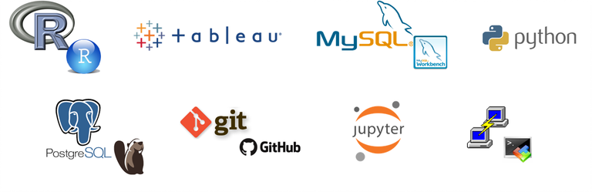
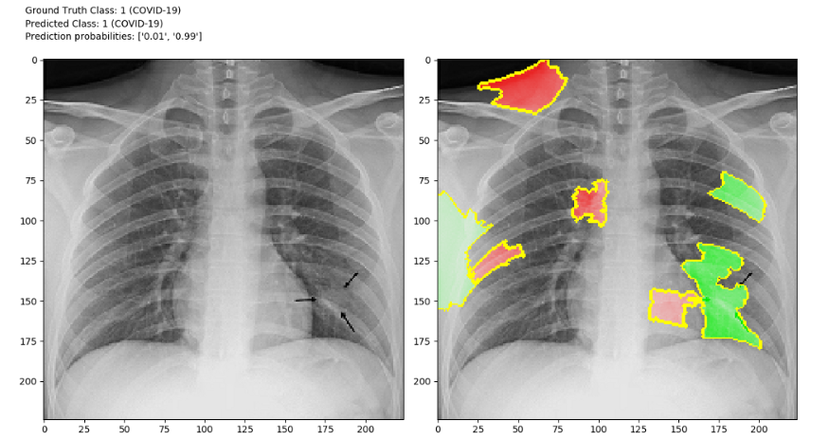
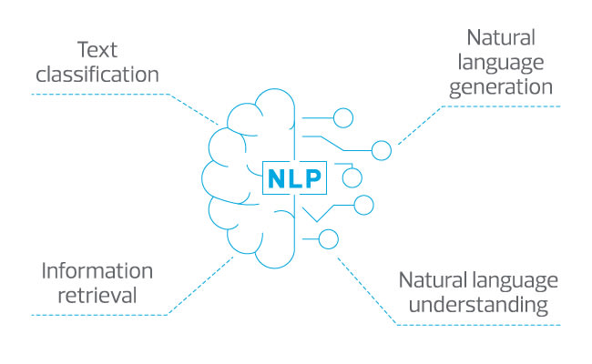
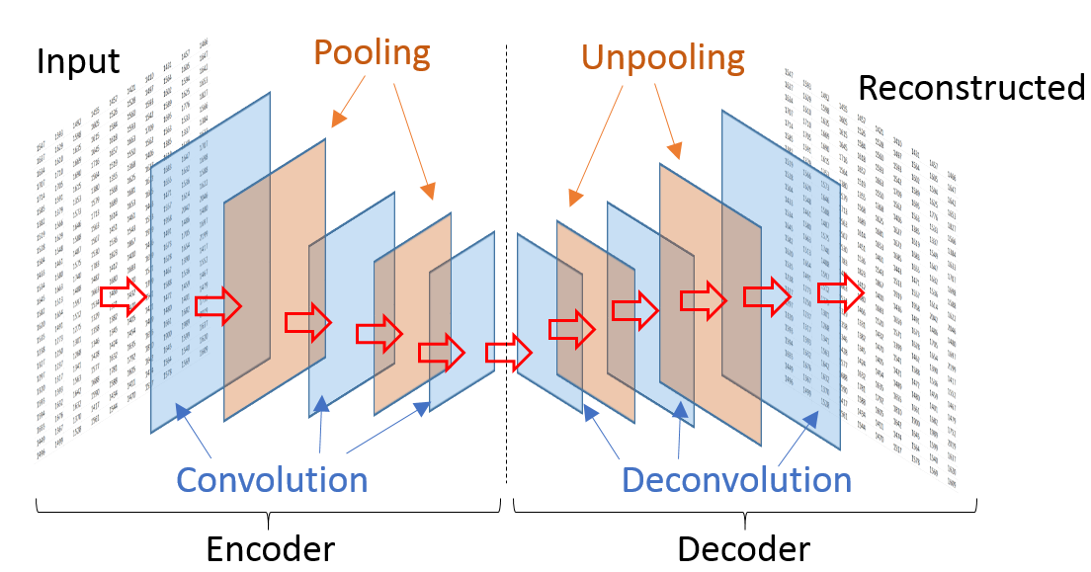
What will we do? - Example project areas
Open-Source Analysis - Building capability to work with open source tools and supporting using the right tool for the right task (e.g. not always excel)
Synthetic data generation - Creating fake or synthetic data for realistic software testing, model benchmarking or to support procurement through open source tools, joint probability models or ‘state of the art’ variational autoencoders.
Natural Language Processing - Creating algorithms which understand, interpret and manipulate human language in order to extract new insights from text, link patient notes to records, or develop speech to text software
AI Validation - In healthcare, the key to using AI is trust. Guidance and development of techniques to explain and demonstrate the appropriate use of AI solutions
https://towardsdatascience.com/covid-cxr-an-open-source-explainable-deep-cnn-model-for-predicting-the-presence-of-covid-19-in-75a83b26cab5

Slide 13
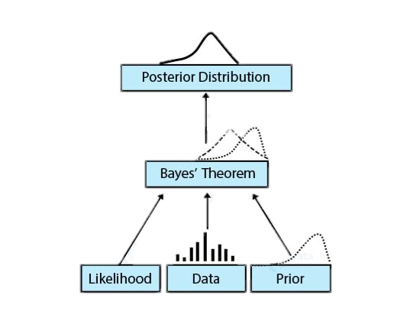
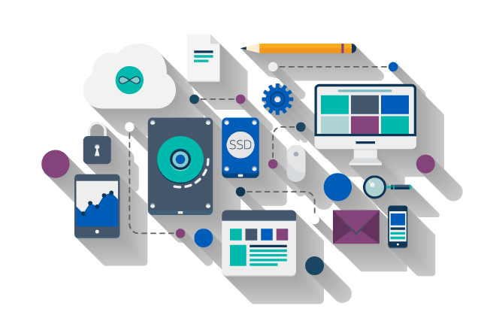
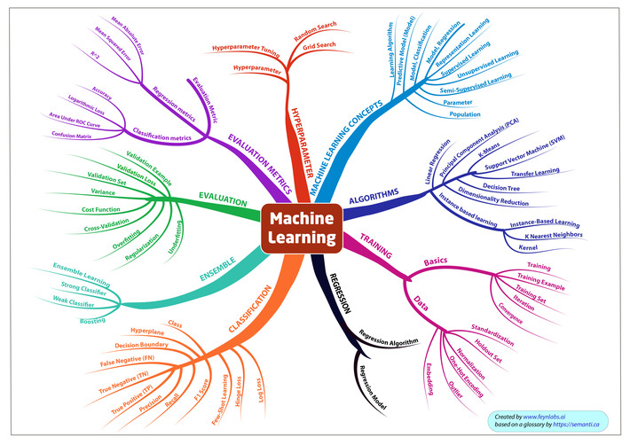
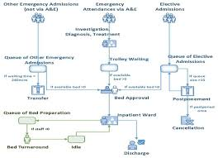
What will we do? - Example project areas
Model Interoperability - Demonstrating a way of working which focuses on creating solutions that are not dependent on the architecture they are built on but instead easily shared and reused across systems
Bayesian Inference - Short-term forecasting with ability to include expert opinions as priors and outputs full uncertainties. Can be extended to share knowledge across different hierarchies so individual trust models are informed by similar trusts
Machine Learning - Exploration of big data to fit a variety of models to known or unknown relationships.
System Modelling - Encouraging the use of discrete event simulations and agent based models to explore individual interactions and cost/benefit of the impact of changes within a system.
……….

